Slide 1
PremierLeague Data Analysis

Slide 2
INTRODUCTION
In this presentation, we will explore premier league season 2024 data.
We will look at different teams such as ManchesterUnited, Liverpool, ManchesterCity etc and how much goal they have conceded, scored, wins, losses,draw etc.

Slide 3
Column Description
Team: The name of the football team.
goals_scored: The total number of goals scored by the team during the season.
goals_conceded: The total number of goals conceded by the team during the season.
wins: The number of matches won by the team.
draws: The number of matches that ended in a draw.
losses: The number of matches lost by the team.
points: The total number of points accumulated by the team (based on wins and draws).
goal_difference: The difference between goals scored and goals conceded (goals scored minus goals conceded)
rank: The team's final rank in the league standings.

Slide 4
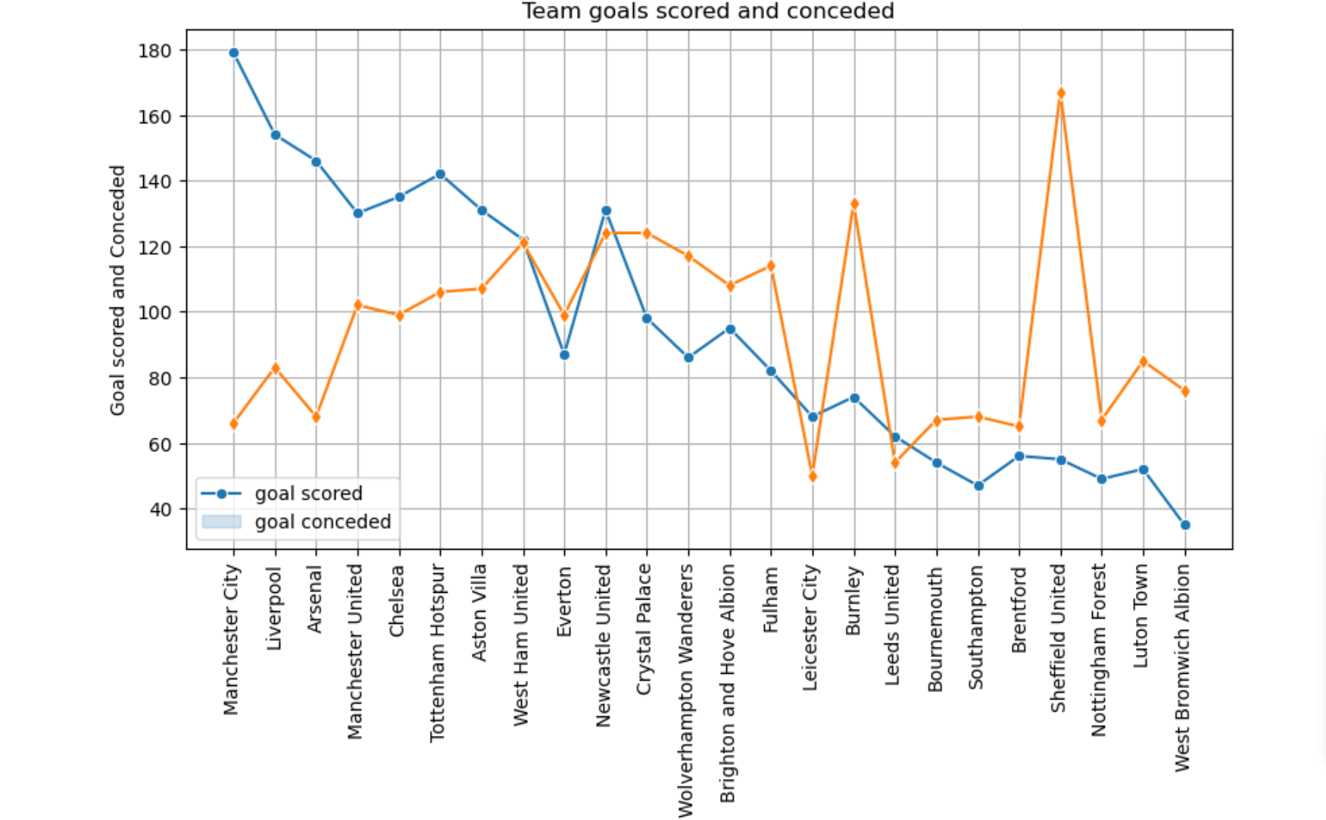
Trends in goalscored and goalconceded in premierleague(2024)

Slide 5
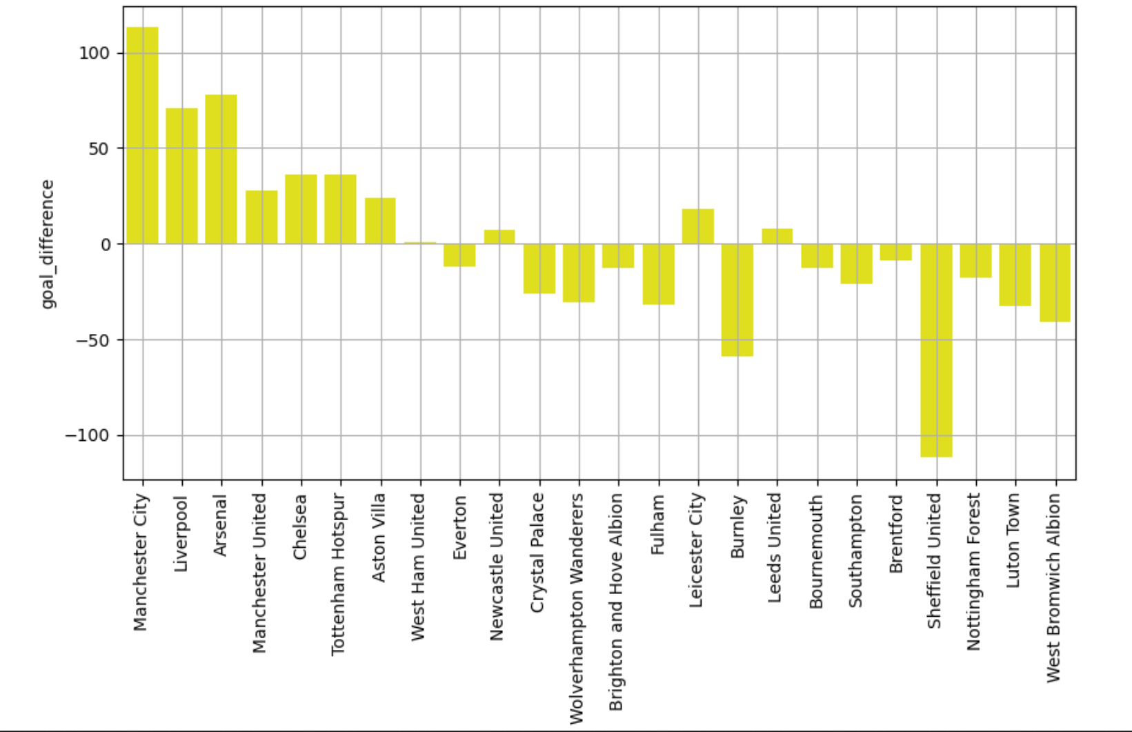
Goal difference of each team

Slide 6
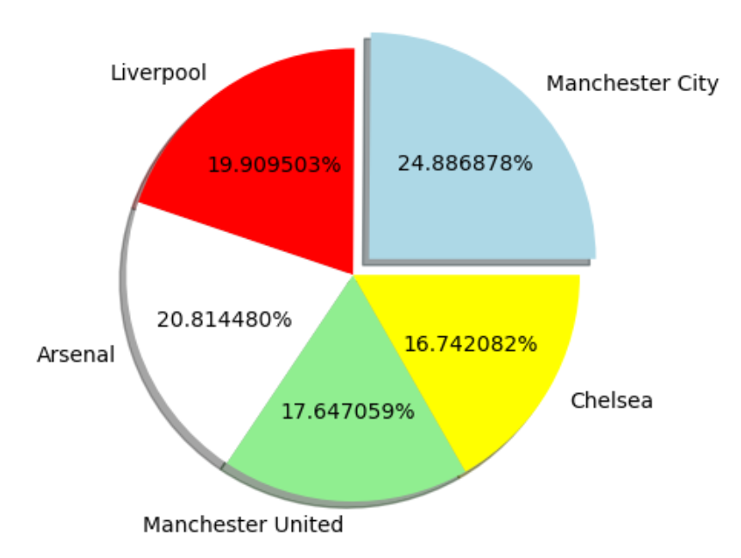
Top 5 Teams with their Win rate

Slide 7
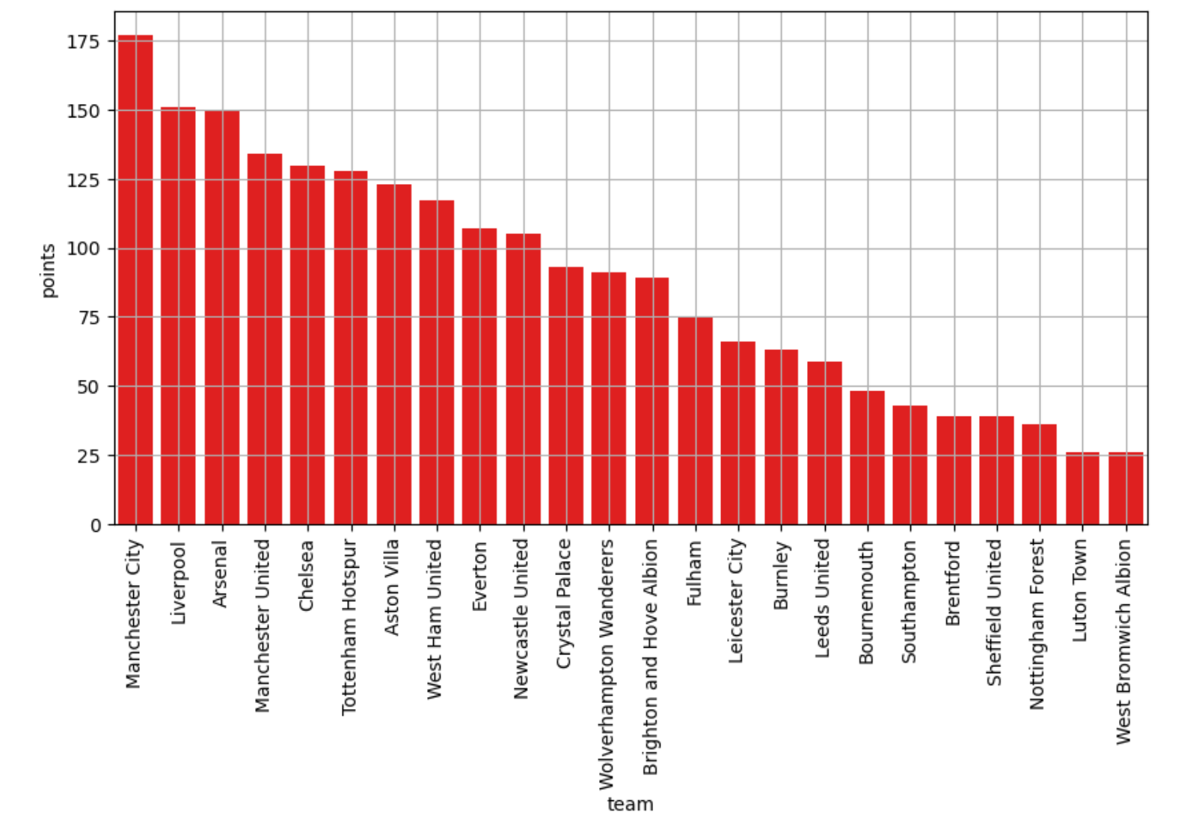
Analyzing Point Distribution of Each Team

Slide 8
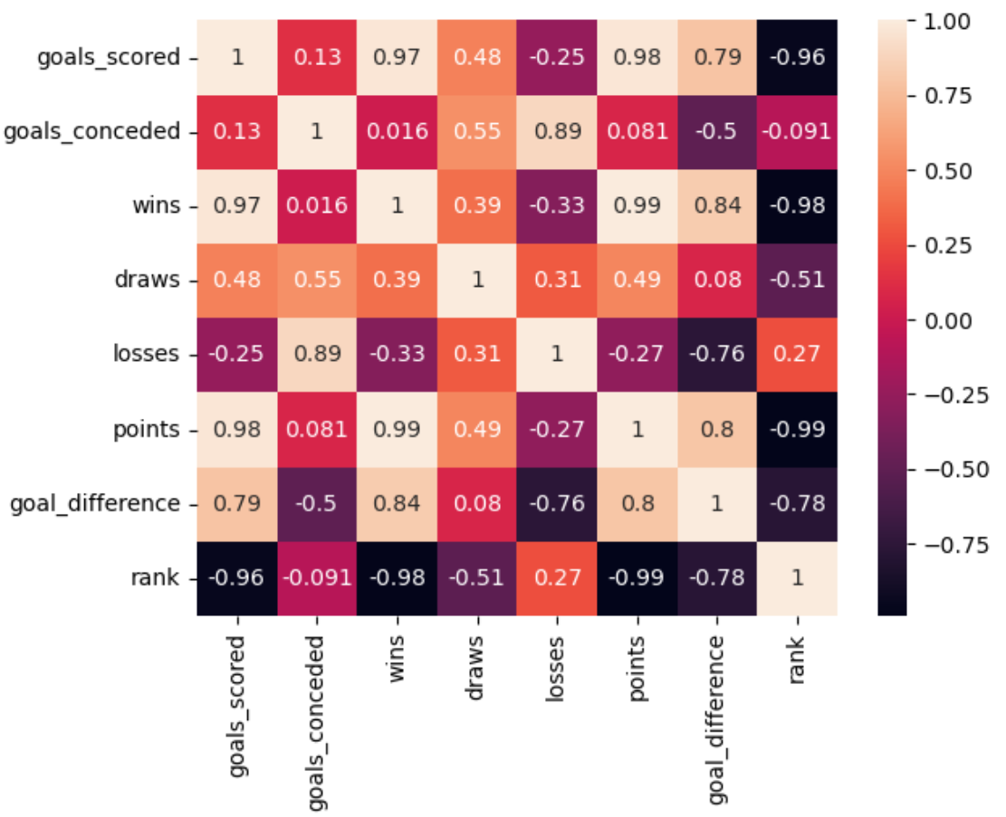
Heatmap of Each Features

Slide 9
Conclusion
From Analyzing this data we can understand that the team ManchesteCity, Liverpool, Arsenal, Chelsea, ManchesterUnited have performed very well in premier league season(2024)

